Slide 1

BLOOD DONATION PORTAL

Slide 2
Aim And Mission
In this Pandemic(COVID-19) situation people and lots of hospitals are suffering from shortage of blood, the aim is to help people to find blood easily from this portal.
Here, people can get blood and donate blood easily and by this blood donation portal we can save lives of many people.

Slide 3
Concepts used
Abstract class
Polymorphism
Inheritance
Filing
Static Variable
Encapsulation

Slide 4
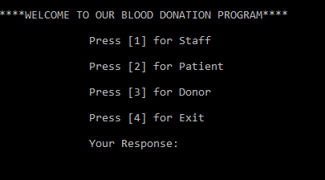
Glimpse Of Program

Slide 5
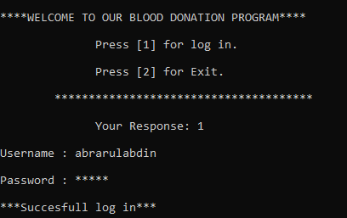
Staff Portion

Slide 6
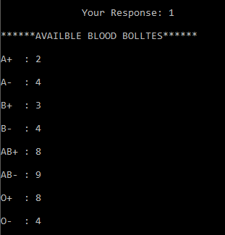
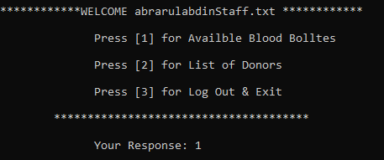
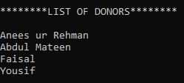
List Of Donor Since Starting of Program
Available Blood Bottles
Options for Staff after Log In

Slide 7
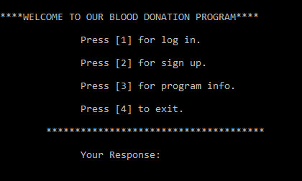
Patient Portion

Slide 8
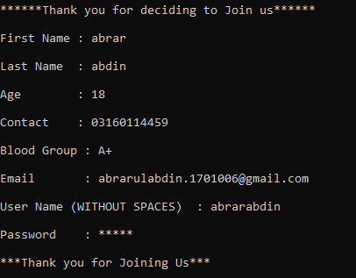
Sign Up

Slide 9
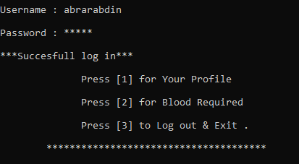
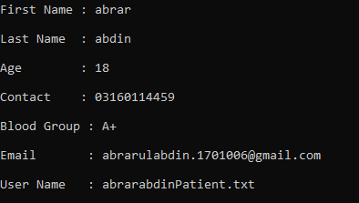
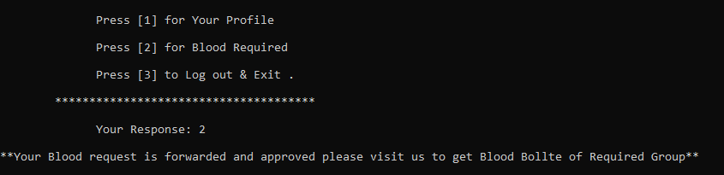
Log In
Your Profile
Blood Required

Slide 10
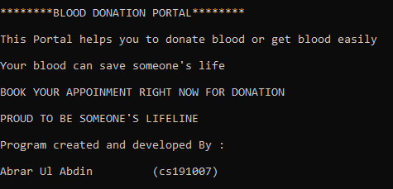
Program Info

Slide 11
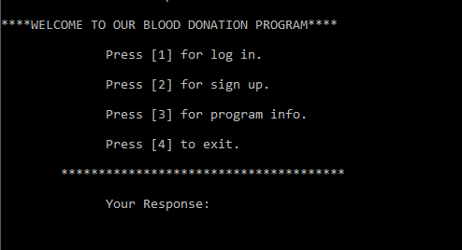
Donor Portion

Slide 12
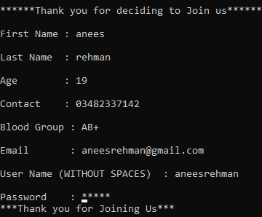
Sign Up

Slide 13
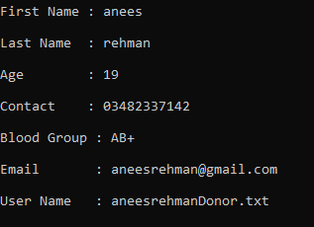
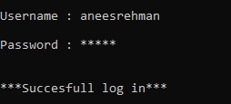
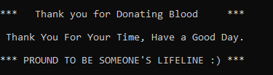
Log In
Your Profile
Donating Blood

Slide 14
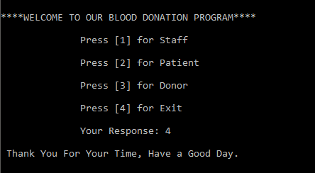
Exit

Slide 15

THANKYOU!
PROGRAM CREATED BY:

